Slide 1
Insights using MySQL to explore Global Trade Item Number (GTIN) data structures
Randy Lisbona, Marvin Scott, Vinh Le
SMU MSDS 7330
File Organization and Database Management
Section - 403
Dec 2016
Github Repository: https://github.com/rlisbona/MSDS-7330-Term-Paper-1

Slide 2
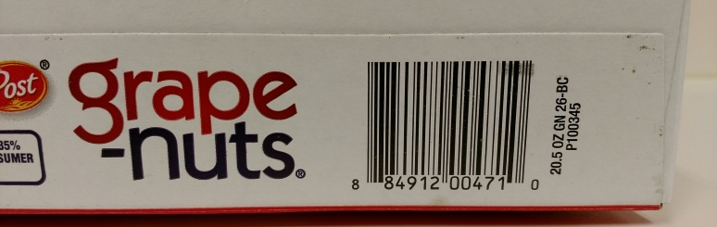
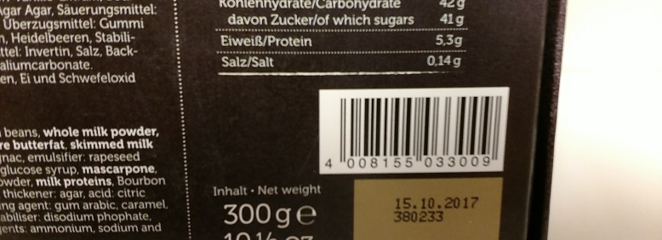

Global trade item numbers
“UPC-A” in north america
“EAN-13” in europe
General Format: -Optional Indicator prefix (packaging level)
-Unique Global Company Prefix (GCP)
-Company assigned item id
-Check digit
-Encoded in a machine readable “Data Carrier”
-Typically Linear barcodes, 2D matrix codes and RFID also supported
GCP numbers are assigned by GS1.ORG to ensure unique numbers globally. GCP does not define or maintain item id’s.

Slide 3
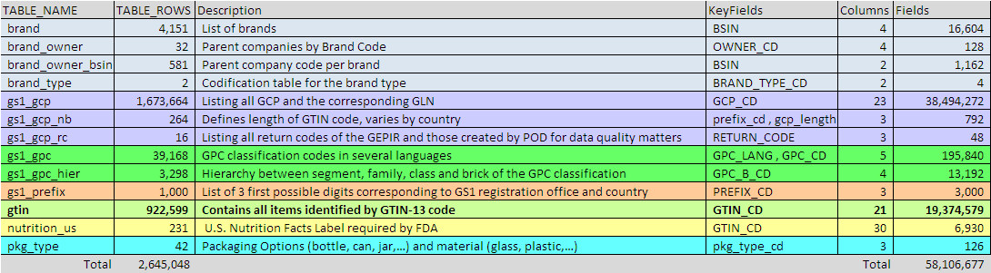
Product Open Data Install on local mysql server
Data Source: Product Open Data Subset of Global Trade Item numbers and related data http://www.product-open-data.com/download/
Download File : pod_web_2014.01.01_01.sql.gz
(58 KB zipped, 432 KB native file size)
Unzip and open/run in mySQL Community Workbench
Record counts and keyfields
13 tables, 2.6 M rows, 58M fields

Slide 4
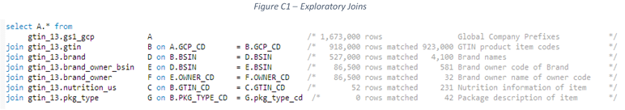
Exploratory steps
Exploratory mysql sourcecode: https://github.com/rlisbona/MSDS-7330-Term-Paper-1/blob/master/Explore/Explore%20gtin_13.sql
Contains example Queries to:
Count records in each table
Determine primary keys
Check for secondary indexes (none found)
Extract example records from each table
Count matching records between related tables
Queries for summary charts in the term paper
Initial exploratory queries appeared to show a lot of useful data
But linked queries showed as we added more tables,
we had fewer and fewer matching records

Slide 5
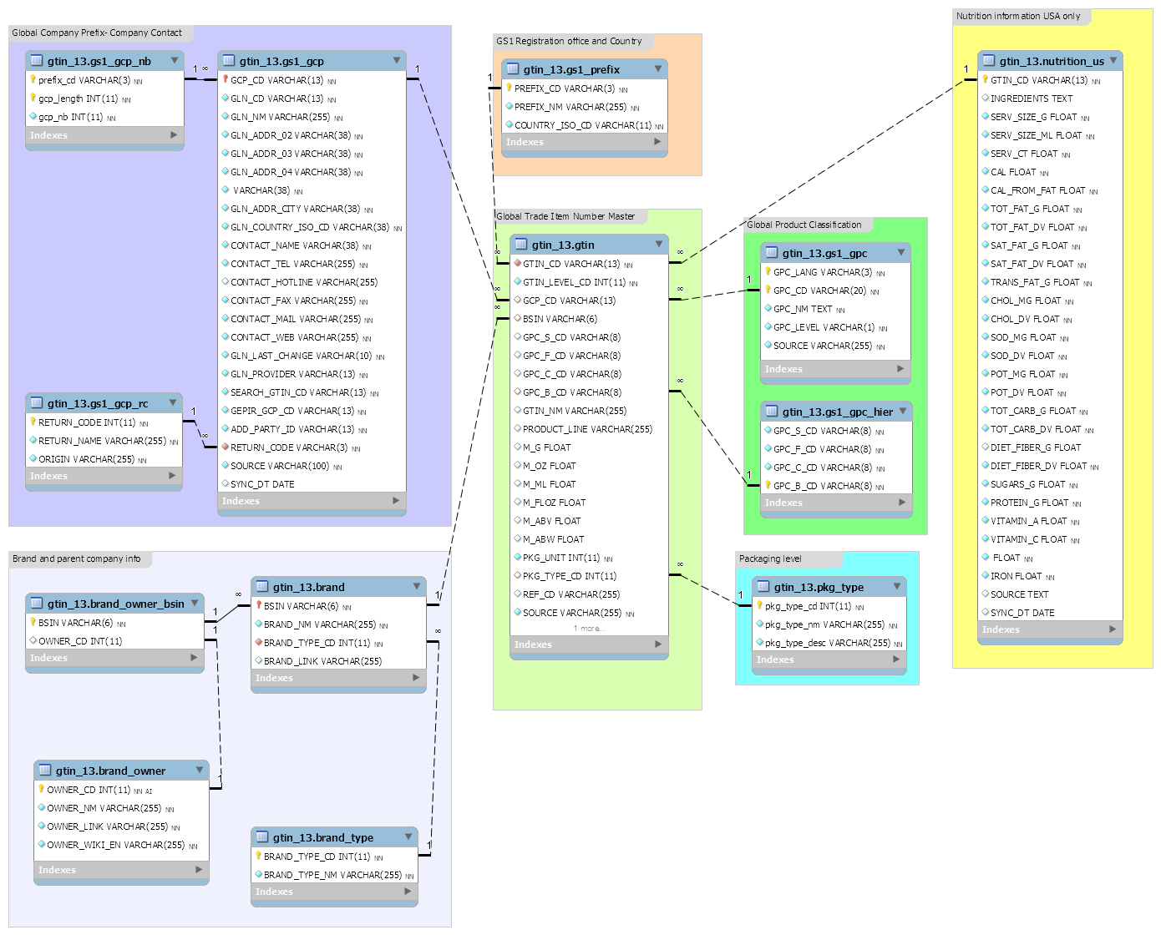
Product Open Database Schema
GS1 Registration Country
Brand and company contact details
Nutrition
Global Product Class Type
GTIN
(Unique Item ID)
Packaging
Parent Company
GTIN_CD = Global Trade Item Number
BSIN = Brand Standard Identifier Number
GCP_CD = Global Company Prefix code

Slide 6
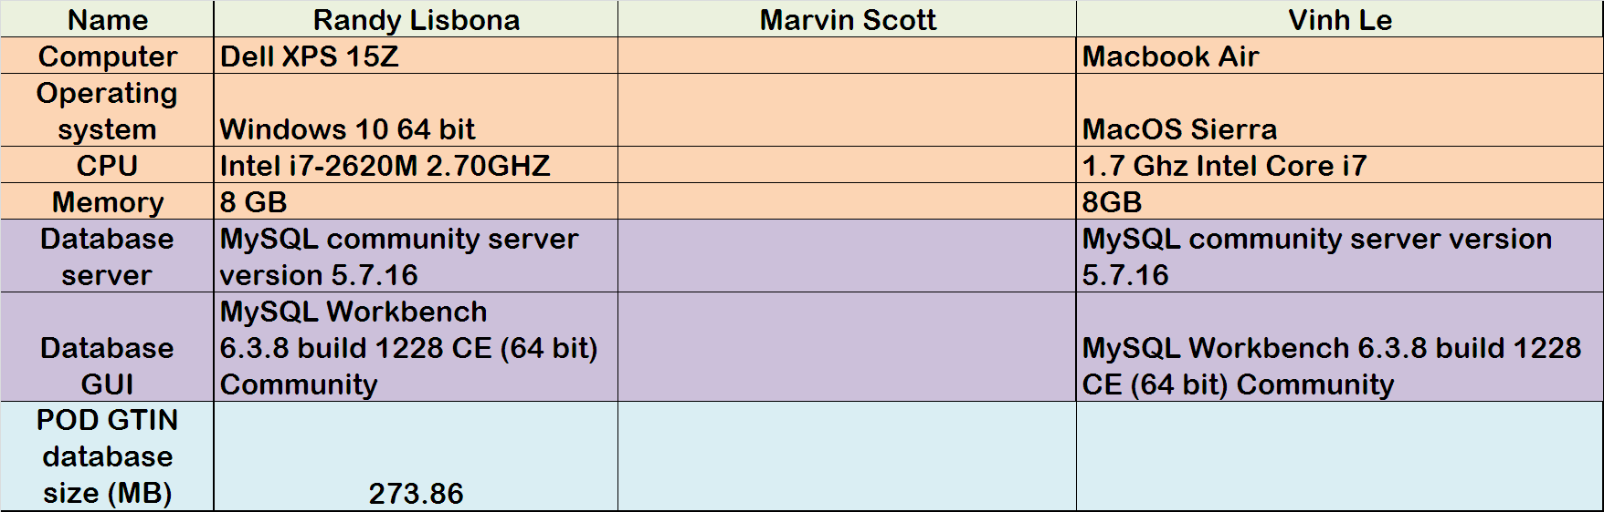
Host PC, operating system and Database details used for the project

Slide 7
GTIN/POD Summary
GS1.ORG is a global standards organization for global trade item indentification
Global Trade Item Number (GTIN) is one of 11 numbering systems maintained by GS1
GS1 does not maintain or publish the GTIN detail records
Each company shares GTIN and related information with trading partners
Product Open Database (POD) is one of several attempts at creating a global list of GTIN codes.
POD does not show any updates after 1/1/2014, so appears to be abandoned.
MySQL was used in this project to explore and learn about GTIN and POD data.

